Slide 1
Prompt learning
提示学习

Slide 2
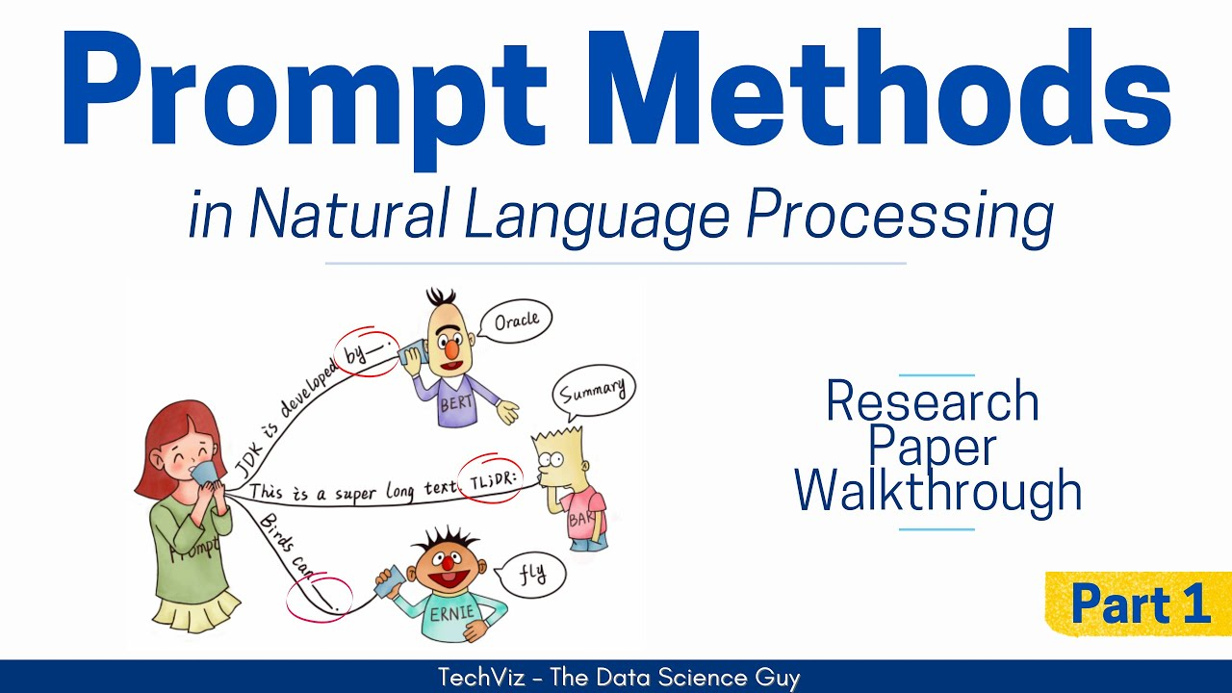
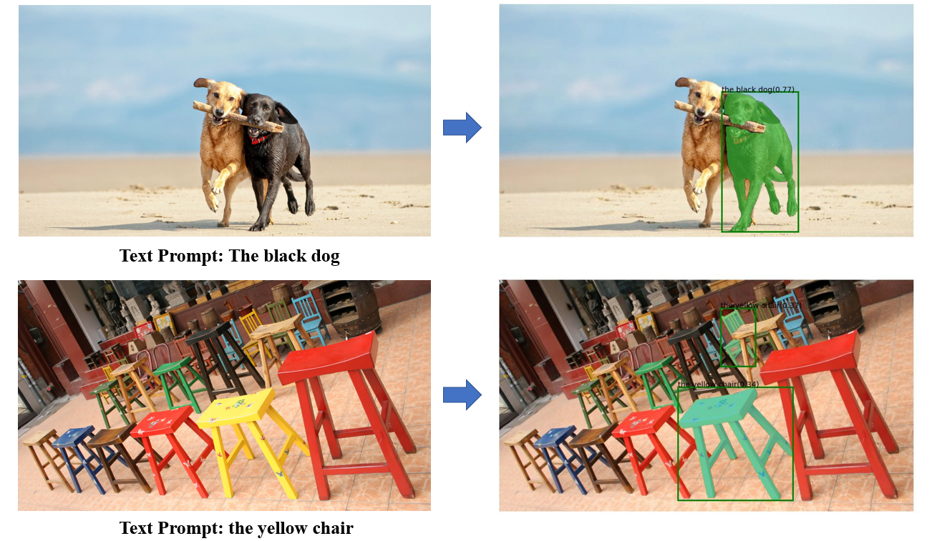
What is this?
Prompt engineering is a relatively new discipline for developing and optimizing prompts to efficiently use language models (LMs) for a wide variety of applications and research topics.

Slide 3
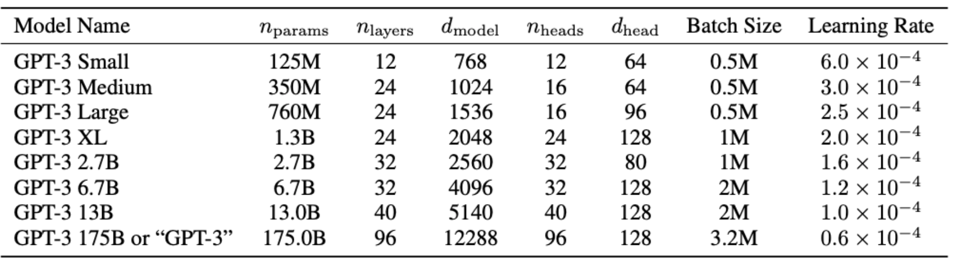
Development Line before Prompting
fine-tuning?
Pre-trained Language Models (PLM)
Pre-train in large-scale unlabeled corpus and then fine-tune in “small-scale” downstream data have brought breakthrough on many NLP tasks
It is hard to tune all parameters when PLM is becoming larger and larger
GPT: Generative Pre-trained Transformer

Slide 4
Development Line before Prompting
Pre-trained Language Models (PLM)
Pre-train in large-scale unlabeled corpus and then fine-tune in “small-scale” downstream data have brought breakthrough on many NLP tasks
It is hard to tune all parameters when PLM is becoming larger and larger
GPT: Generative Pre-trained Transformer

Slide 5
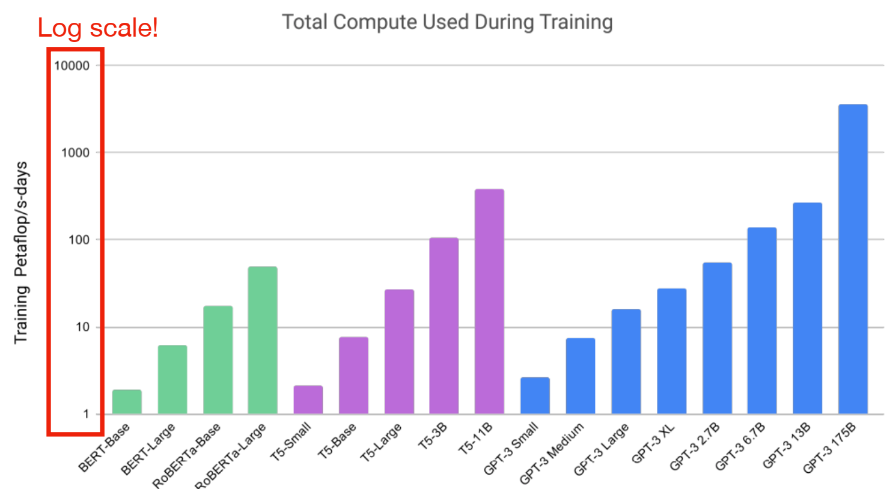
Development Line before Prompting

Slide 6
2022-2023
PaLM (Google): 540B params, 118 layers, 18432 d_model, 780 billion training tokens Model not avaliable
ChatGPT (OpenAI): Params, layers, dimensionality, training data size unknown Model available only through blackbox API
GPT4 (OpenAI): Params, layers, dimensionality, training data size unknown Model parameters publicly available!
Bard (Google): Params, layers, dimensionality, training data size unknown
Model available only through blackbox API
LLaMa (Meta): 65B params, 80 layers, 8192 d_model, 1.4 trillion tokens of training data Model parameters publicly available!

Slide 7
Two solutions
Model compression and inference speedup, including knowledge distillation, quantization, parameter sharing, module replacing, and early exit
Parameter-efficient tuning methods, including Adapters, Part Parameter Tuning, and Prompt Tuning

Slide 8
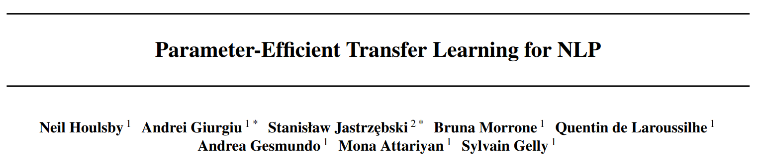
Adapters
ICML’19
Fine-tuning large pre-training model is an effective transfer mechanism, but is parameter inefficient.
Add the adapter module inside the Transformer layer and fix the PLM
Adapter modules yield a compact and extensible model, add only a few parameters per task, and new tasks can be added without revisiting previous ones.

Slide 9
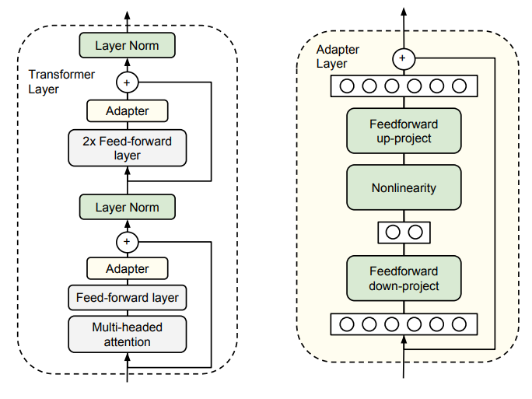
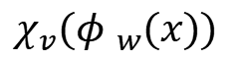
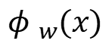
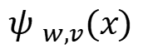
Adapters
bottleneck
Network
$${φ }_{w}(x)$$
Feature-based transfer:
Fine-tuning
Adapter tuning
$${χ_{v}(φ }_{w}(x))$$
$${φ }_{w}(x)$$
$${ψ }_{w,v}(x)$$

Slide 10
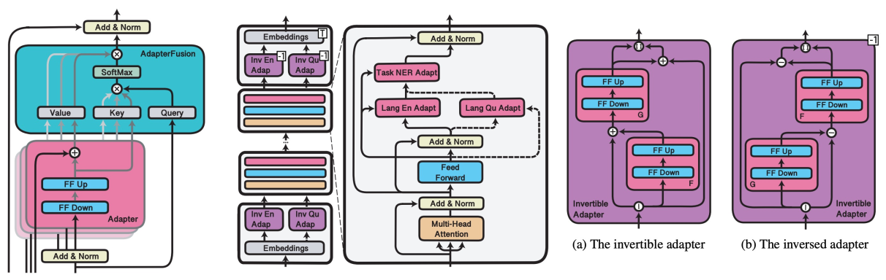
Adapters
Can be used in Cross-task/Cross-lingual/Cross-Modal transfer

Slide 11
Part Parameter Tuning
BitFit: Simple Parameter-efficient Fine-tuning for Transformer-based Masked Language-models (ACL 2022)
Only the bias-term (or a subset of them) is fine-tuned
Parameter-Efficient Transfer Learning with Diff Pruning (ACL 2021)
Learn a diff vector and add this vector to the pre-trained model parameters
Raise a Child in Large Language Model: Towards Effective and Generalizable Fine-tuning (EMNLP 2022)
First find a subset of parameters and generate the gradient mask, then update part of the parameters based on the gradient mask

Slide 12
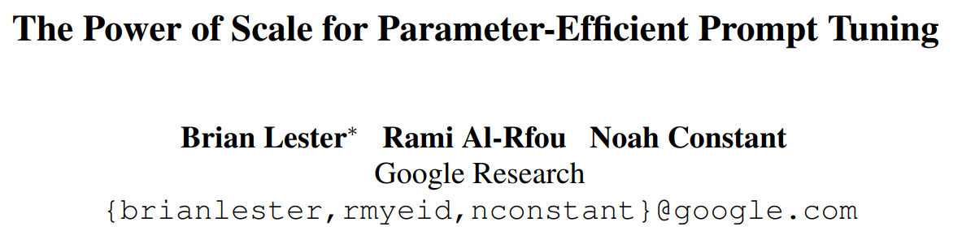
Prompt Tuning
Model tuning requires making a task-specific copy of the entire pre-trained model for each downstream task and inference must be performed in separate batches.
Prompt tuning only requires storing a small task-specific continuous vectors for each task, and directly optimizes them via gradients during fine-tuning, enables mixed-task inference using the original pre-trained model.

Slide 13
Prompt Tuning
Model tuning requires making a taskspecific copy of the entire pre-trained model for each downstream task and inference must be performed in separate batches.
Prompt tuning only requires storing a small task-specific prompt for each task, and enables mixed-task inference using the original pretrained model.

Slide 14
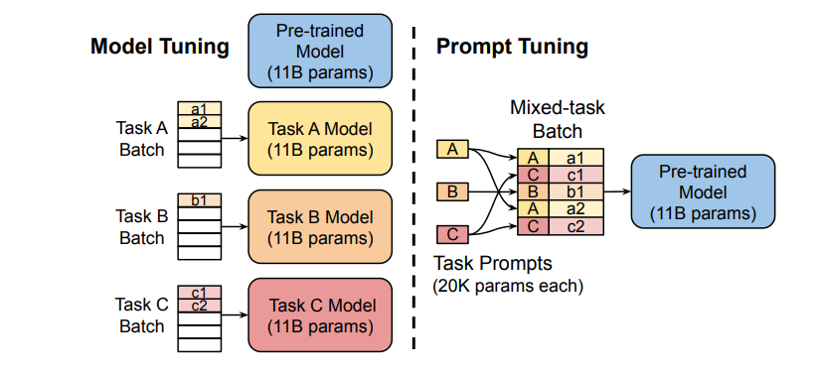
Prompt Tuning

Slide 15
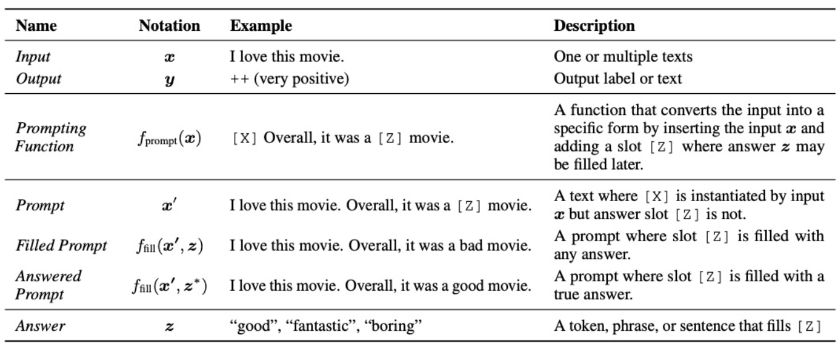
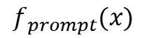
Prompt Tuning
$$f_{prompt}(x)$$
Prompt learning is the process to creat a prompting function that maximize the performance on downstream tasks.

Slide 16
Language model prompting to the rescue!
GPT-3 (Brown et al., 2020): In-context learning
• natural language instruction and/or a few task
demonstrations ⟶ output
“Translate English to German:” That is good ⟶ Das is gut
• no gradient updates or fine-tuning

Slide 17
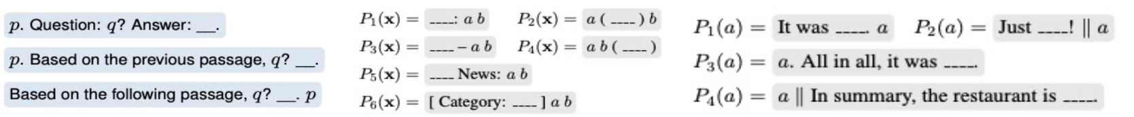
Prompt Tuning
Prompt types-- manual
Cloze prompt: the language model is required to fill in the blanks of a textual string
Prefix prompt: the language model is required to generate the textual string by the given input as well as a prefix string.

Slide 18
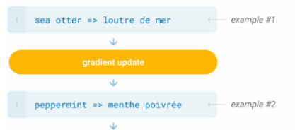
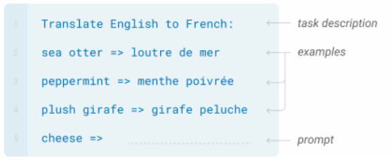
Prompt Tuning
Fine-tuning: the model is trained via repreated gradient updates using a large corpus of example tasks.
In addition to the task description, the model sees a few examples of the task. No gradient updates are performed.

Slide 19
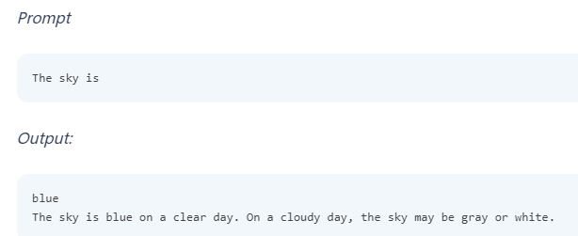
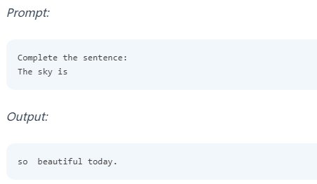
Prompt Tuning
instruction/question
Example：

Slide 20
Prompt Tuning
Prompt types-- manual
Cloze prompt: the language model is required to fill in the blanks of a textual string
Prefix prompt: the language model is required to generate the textual string by the given input as well as a prefix string.
Advantages:
help leverage the knowledge contained in pre-trained language model
can be mannual designed with prior experitise
provide a perspective of better understanding the pre-trained language model
Disadvantages:
not flexible enough
require much prior expertise

Slide 21
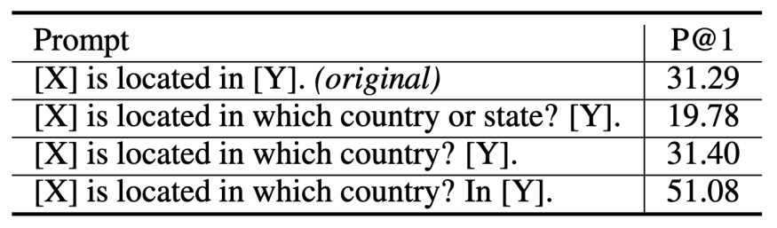
Prompt Tuning--sub-optimal and sensitive discrete/hard prompts
Discrete/hard prompts: natural language instructions/task descriptions
Problems:
requiring domain expertise/understanding of the model’s inner workings
performance still lags far behind SOTA model tuning
sub-optimal and sensitive: prompts that humans consider reasonable is not necessarily effective for language models; pre-trained language models are sensitive to the choice of prompts

Slide 22
Prompt Tuning--shifting to continuous/soft prompts
Continuous/soft prompts: additinal learnable parameters injected into the model
manual prompt design
mining and paraphrasing based methods to automatically augment the prompt sets
gradient-based search for improved discrete/hard prompts
automatic prompt generation using a separate generative language model (T5)
learning continous/soft prompts

Slide 23
Prompt Tuning
Prompt types-- automated
Automatically search templates in discrete space (word) or continuous space (embedding)
Discrete prompt: Prompt Mining, Prompt Paraphrasing, Gradient based Search
Continous prompt: Prefix Tuning, Tuning Initialized with Discrete Prompts, Hard-Soft Prompt Hybrid Tuning
Advantages:
Relax the constraint of embedding space
Remove the restriction that the template is parameterized by the PLM parameters
Disadvantages:
Can hardly be interpretable
Usualy, can not be easily transferred

Slide 24
Prompt Tuning--it remains unclear how to learn continuous/soft prompts effectively?
P-tuning (Liu et al., 2021): encode dependencies between prompt tokens using a BiLSTM network
Prefix Tuning (Li and Liang., 2021): inject prompts at different positions of the input /model
Soft Prompts (Qin and Eisner., 2021): use ensemble methods, e.g., mixture-of-experts

Slide 25
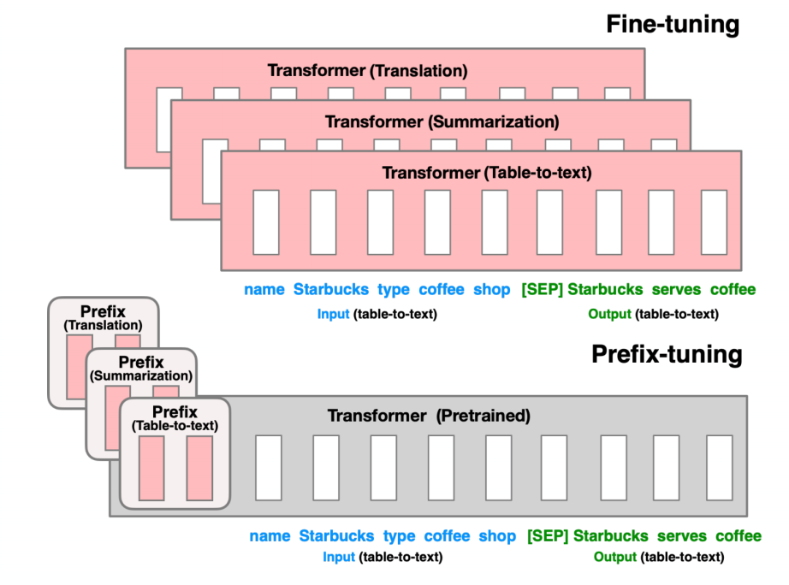
Prefix Tuning (Li and Liang., 2021)
– Prefix-Tuning: Optimizing Continuous Prompts for Generation (ACL 2021)
– Add a prefix before the input and only tune the parameters from the prefix

Slide 26
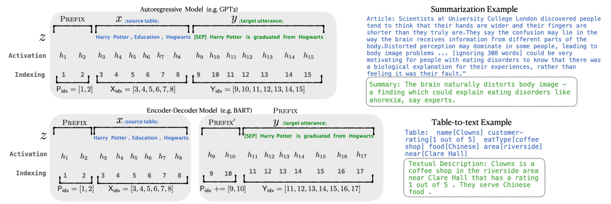
Prefix Tuning (Li and Liang., 2021)
– Prefix-Tuning: Optimizing Continuous Prompts for Generation (ACL 2021)
– Add a prefix before the input and only tune the parameters from the prefix

Slide 27
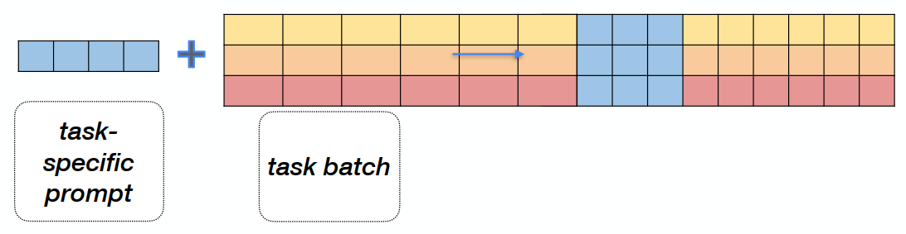
Prompt Tuning (Lester et al., 2021)
What is a prompt in prompt tuning?
a sequence of additional task-specific tunable tokens prepended to the input text
The Power of Scale for Parameter-Efficient Prompt Tuning

Slide 28
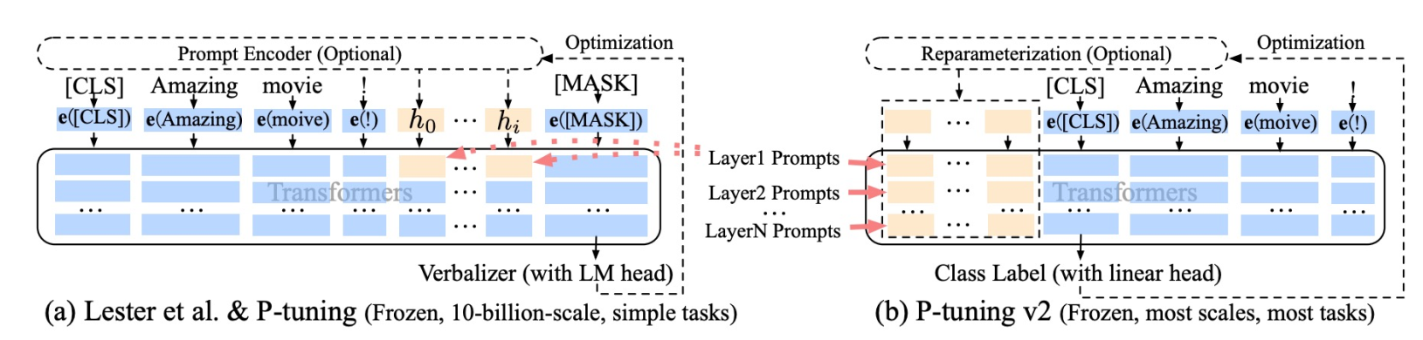
P-Tuning v2
– P-Tuning v2: Prompt Tuning Can Be Comparable to Fine-tuning Universally Across Scales and Tasks (ACL 2022)
– Add prompts in each Transformer layer, which makes the model more stable

Slide 29
Prompt Tuning
Training settings
Zero-shot learning (PLM has been trainied for LM to predict the probability, GPT-3)
Few-shot learning (resource limitation scenarios, PET-TC)
Full-data learning (for best downstream task performance, PTR)

Slide 30
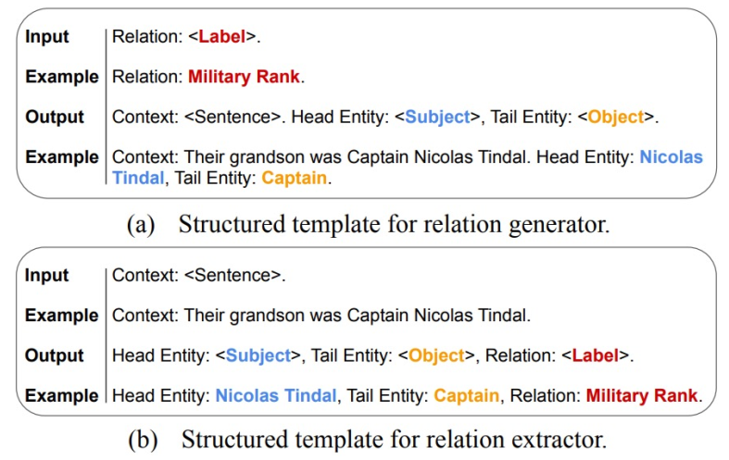
Prompt Tuning
Training settings
Zero-shot learning (PLM has been trainied for LM to predict the probability, GPT-3)
Prompt for Zero-shot Relation Extraction
RelationPrompt: leveraging prompts to generate synthetic data for zero-shot relation triplet extraction

Slide 31
Prompt Tuning
Training settings
Parameter Updating
No prompt, only fine-tuning: Only tuned LM params (BERT, RoBERTa)
Tuning-free prompting: Frozen LM params, no additional prompt params (GPT-3, BARTScore)
Fixed-LM prompt tuning: Frozen LM params, additional and tuned prompt params (Prefix-Tuning, WARP)
Fixed-prompt LM Tuning: Tuned LM params, with fixed additional prompt params (T5, PET-TC)
Prompt + LM tuning: Tune both LM params and additional prompt params (P-Tuning, PTR)

Slide 32
Prompt Tuning
Parameter Updating
No prompt, only fine-tuning: Only tuned LM params (BERT, RoBERTa)
Advantages: simplicity, do not need prompt design. Can also fit to larger training datasets
Disadvantates: LM usually overfit or unstable on small datasets.
Tuning-free prompting: Frozen LM params, no additional prompt params (GPT-3, BARTScore)
Advantages: No parameter update process, which can be applied in zero-shot settings
Disadvantages: requires much prompt engineering with prior expertise; slow at testing, can not easily use large training datasets.

Slide 33
Prompt Tuning
Parameter Updating
Fixed-LM prompt tuning: Frozen LM params, additional and tuned prompt params (Prefix-Tuning, WARP)
Advantages: often outperforms tuning-free prompting, while retain knowledge in LMs and is suitable in few-shot scenarios
Disadvantates: No applicable in zero-shot; the learned representation has limitations in large-data scenarios; prompts are usually hard to human-interpreted.
Fixed-prompt LM Tuning: Tuned LM params, with fixed additional prompt params (T5, PET-TC)
Advantages: prompt or answer engineering is more specific to the task, allowing for more efficient learning
Disadvantages: still reuires manual prompt; LM fine-tuned on one downstram task can not be easily transferred to another downstream task.

Slide 34
Prompt Tuning
Parameter Updating
Prompt + LM tuning: Tune both LM params and additional prompt params (P-Tuning, PTR)
Tune both LM params and additional prompt params
The setting is very similar to the standard pre-train and then fine-tune paradigm
Advantages: most experssive method, which is suitable for large dataset settings
Disadvantates: requires most computational resources.

Slide 35
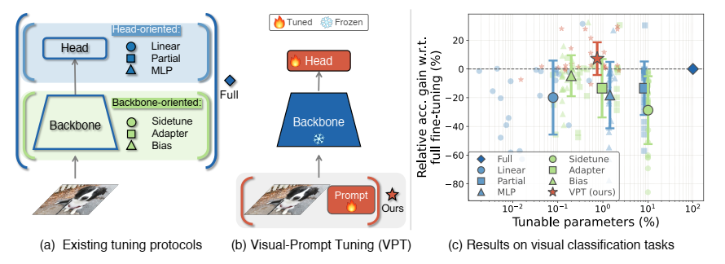
Prompt applications in CV-classification
Visual Prompt Tuning, ECCV 2022
adapt large pre-trained Transformers to downstream tasks
introducing only a small amount (<=1% of model parameters) learnable in the input space while keeping the model backbone frozen, VPT achieves significant performance gains, even outperforms full fine-tuning in many downstream recognition tasks.

Slide 36
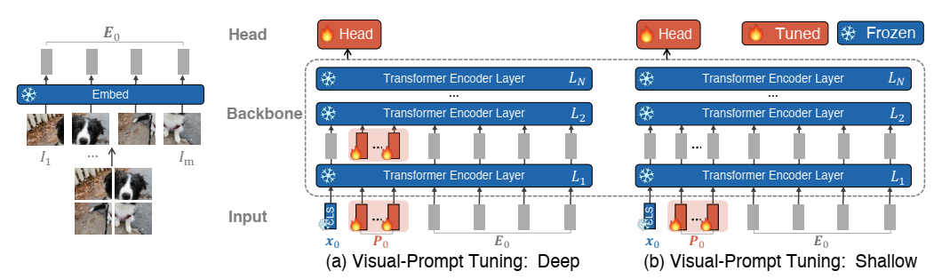
Prompt applications in CV-classification
Visual Prompt Tuning, ECCV 2022
During training on downstream tasks, only the parameters of prompts and linear head are updated while the whole Transformer encoder is frozen.

Slide 37
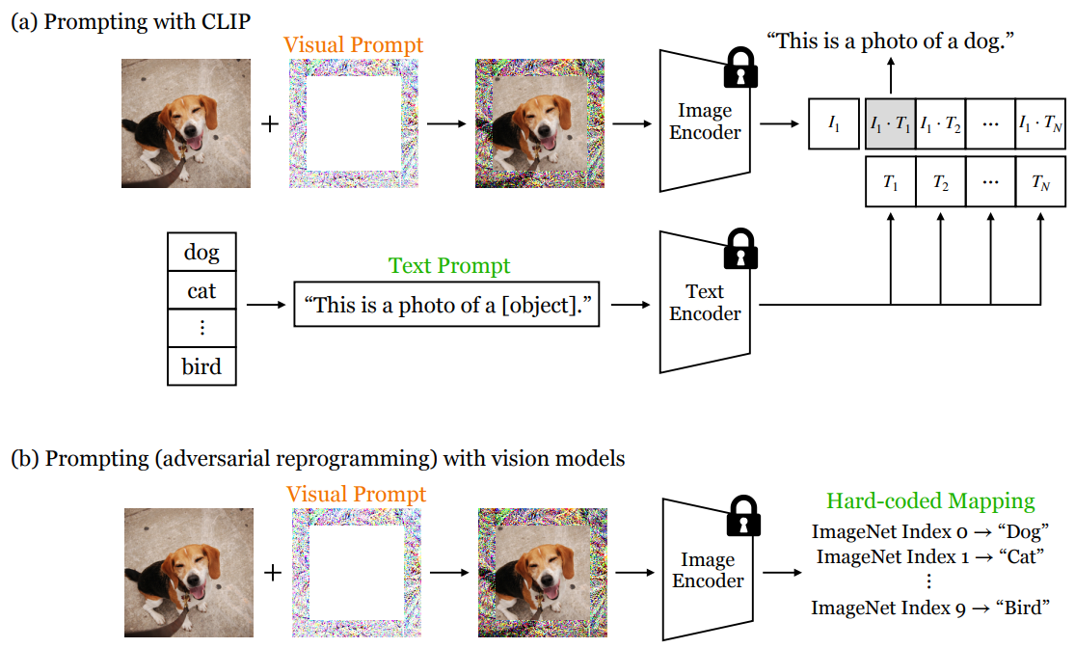
Prompt applications in CV-classification
Exploring Visual Prompts for Adapting Large-Scale Models, 2022
Learn a single image perturbation such that a frozen model prompted with this perturbation performs a new task.

Slide 38
Prompt applications in CV-classification
Exploring Visual Prompts for Adapting Large-Scale Models, 2022
prompting methods: adapt a frozen pre-trained model by modifying the data space.
visual prompt: adapt a model to new tasks by modifying the pixels.
adversarial repreogramming and prompting share the general idea: perform data-space adaptation by transforming the input (i.e., prompt engineering) and/or output (i.e., answer engineering).
treats prompts as a continuous task-specific vector
image perturbation (i.e., soft prompt)

Slide 39
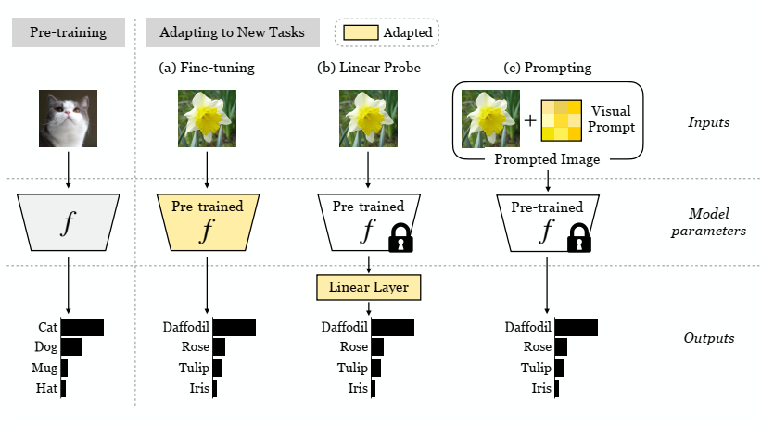
Prompt applications in CV-classification
Exploring Visual Prompts for Adapting Large-Scale Models, 2022
prompting methods: adapt a frozen pre-trained model by modifying the data space.
visual prompt: adapt a model to new tasks by modifying the pixels.

Slide 40
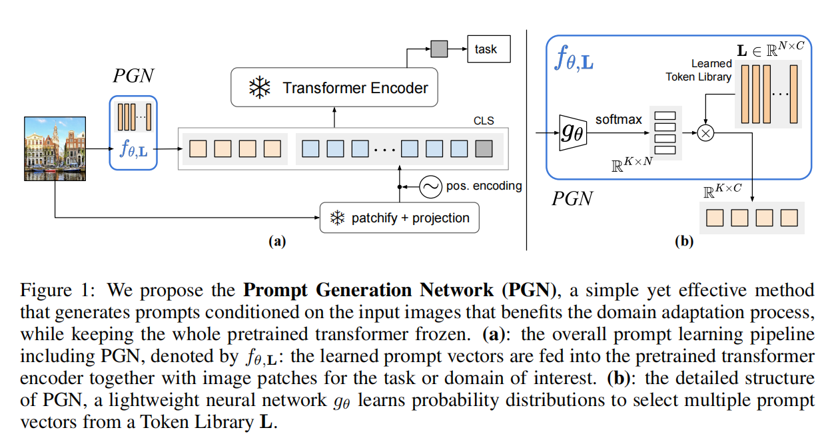
Prompt applications in CV-classification
Prompt Generation Networks for Efficient Adaptation of Frozen Vision Transformers, 2022
Prompt Generation Network (PGN) that generates input-dependent prompts by sampling from a learned library of tokens.

Slide 41
Prompt applications in CV-classification
Self-Supervised Convolutional Visual Prompts, CVPR 2023
Existing vision prompts optimize a high-dimensional additive vector, and require labeled data on training.
This paradigm fails on test-time adaptation when labeled data is unavailable, where the high-dimensional visual prompt overfits to the self-supervised objective.
Convolutional visual prompts for test-time adaptation without label.
the self-supervised tasks are used as a proxy, which captures similar information and structures as the target task.
the distribution shift in visual data is often structured and satisfying translaton equivariance.

Slide 42
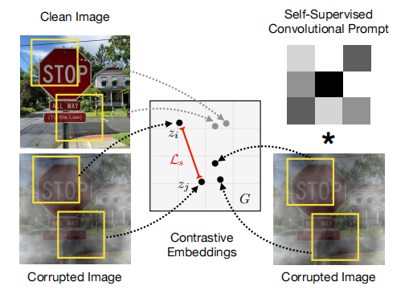
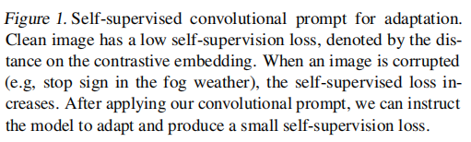
Prompt applications in CV-classification
Self-Supervised Convolutional Visual Prompts, CVPR 2023
x = x + v;
x = [x;v];
x = conv(x,v)

Slide 43
Prompt applications in CV-classification
Understanding and Improving Visual Prompting A Label-Mapping Perspective, CVPR 2023
It remains elusive why VP stays effective even given a ruleless label mapping (LM) between the source classes and the target classes.
How is LM interrelated with VP?
An affirmative answer that a better ‘quality’ of LM can consistently improve the effectiveness of VP.
Re-maps the source labels to the target labels and progressively improves the target task accuracy of VP.

Slide 44
Prompt applications in CV-classification
Understanding and Improving Visual Prompting A Label-Mapping Perspective, CVPR 2023
VP can reprogram a fixed, pre-trained source model to accomplish downstream tasks in the target domain by simply incorporating universal prompts into downstream data points.
VP integrates an input transformation and/or an output transformation to reprogram the fixed source model to accomplish a new target task.
The input transformation is typically realized by incorporating (data-agnostic) input perturbations (i.e., prompts) into input samples.
The output transformation is given by a function that maps source labels to target labels, known as label mapping (LM).
What is the rationality behind LM and how to explore its influence on VP?
How to interpret LM and the seemingly random perturbation pattern in VP?

Slide 45
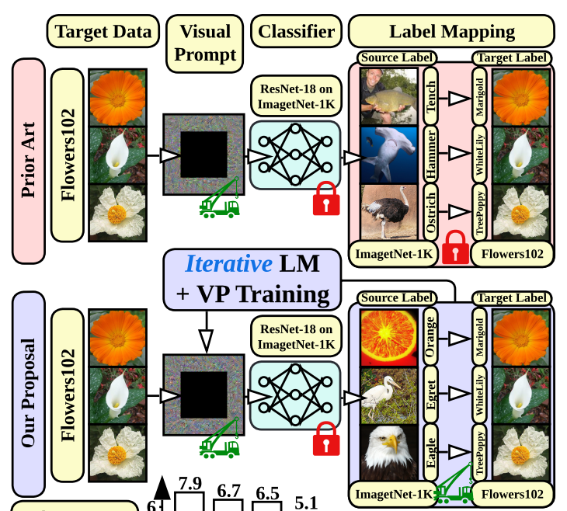
Prompt applications in CV-classification
Understanding and Improving Visual Prompting A Label-Mapping Perspective, CVPR 2023
Generally speaking, VP aims to generate a universal input perturbation template (i.e., ‘visual prompt’) and leverage a source-target LM (label mapping) in order to drive the fixed source model (e.g., pretrained on ImageNet-1K) to conduct a target task (e.g., Flowers102 image classification).
Our proposal couples the design of LM with VP training. The resulting LM-VP co-design improves target task accuracy across a variety of target image classification tasks using a fixed ImageNet-pretrained source model.

Slide 46
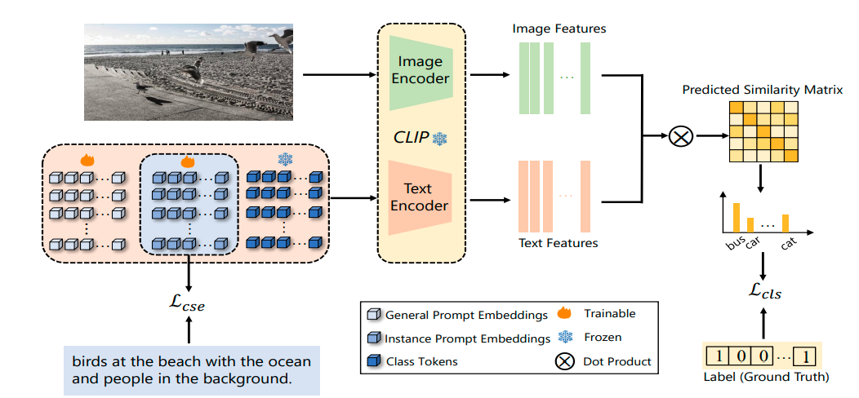
Prompt applications in CV-long-tail
LMPT: Prompt Tuning with Class-Specific Embedding Loss for Long-Tailed Multi-Label Visual Recognition, Arxiv 2023
we propose a unified framework for LTML capturing the semantic feature interactions between categories by combining text and image modality data and improving the performance synchronously on both head and tail classes.

Slide 47
Prompt applications in CV-segmentation
Prompt-Matched Semantic Segmentation, 2022
Motivation: explore how to effectively and efficiently adapt pre-trained visual foundation models to various downstream tasks of semantic segmentation.
Dividing the pre-trained backbone with frozen parameters into multiple stages and perform prompt learning between different stages, which makes the proposed scheme applicable to various architectures of CNN and Transformer.
A lightweight Semantic-aware Prompt Matcher (SPM) is designed to progressively learn reasonable prompts with a recurrent mechanism, guided by the rich information of interim semantic maps.

Slide 48
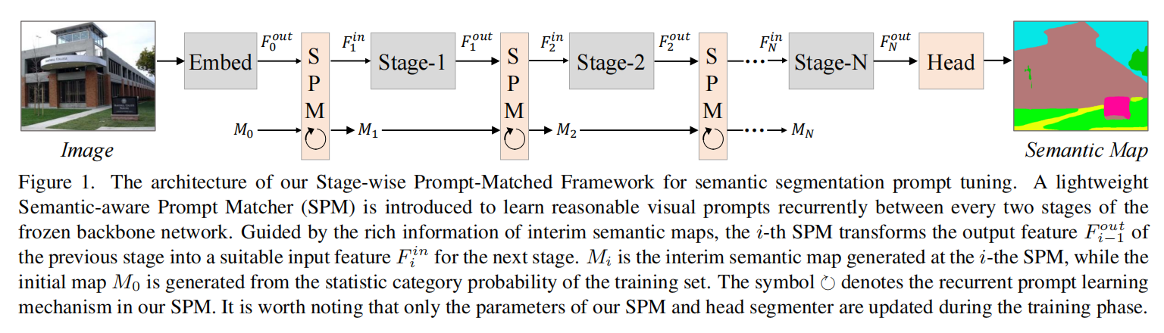
Prompt applications in CV-segmentation
Prompt-Matched Semantic Segmentation, 2022

Slide 49
Prompt applications in CV
Multitask Vision-Language Prompt Tuning, 2022
During training on downstream tasks, only the parameters of prompts and linear head are updated while the whole Transformer encoder is frozen.

Slide 50
Prompt applications in CV
Learning to Prompt for Vision-Language Models, IJCV 2022
During training on downstream tasks, only the parameters of prompts and linear head are updated while the whole Transformer encoder is frozen.

Slide 51
Prompt applications in CV
Prompt Distribution Learning, CVPR 2022
During training on downstream tasks, only the parameters of prompts and linear head are updated while the whole Transformer encoder is frozen.

Slide 52
Prompt applications in CV
Conditional Prompt Learning for Vision-Language Models, CVPR 2022
During training on downstream tasks, only the parameters of prompts and linear head are updated while the whole Transformer encoder is frozen.

Slide 53
Prompt applications in CV
DenseCLIP: Language-Guided Dense Prediction with Context-Aware Prompting, CVPR 2022
During training on downstream tasks, only the parameters of prompts and linear head are updated while the whole Transformer encoder is frozen.

Slide 54
Prompt applications in CV-generalization
Prompt Vision Transformer for Domain Generalization, Arxiv 2022
Motivation：ViT cannot generalize well to unseen domain.
Embedding the knowledge of source domain in domain prompts for target domain prediction.
Each domain prompt learns domain -specific knowledge, and prompt adapter produces suitable prompt for each input images.
The prompt adapter exploits the similarity between feature of OOD image and source domain, to integrate the source domain knowledge.

Slide 55
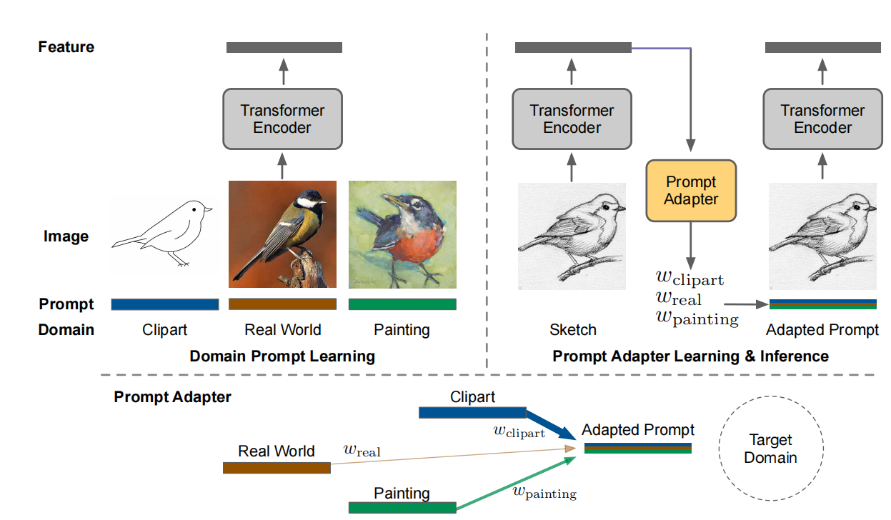
Prompt applications in CV-generalization
Prompt Vision Transformer for Domain Generalization, Arxiv 2022
prepended before ViT input tokens from the corresponding source domain

Slide 56
Prompt applications in CV-generalization
Visual Prompt Tuning for Test-time Domain Adaptation, Arxiv 2022
Motivation: TTA without accessing the source data. data-efficient prompt tuning.
two key ingredients:
Pluging visual prompts into ViT and only tunes these source-initialized prompts during adaptation;
Bootstraping the source representation to target domain by memory bank-based online pseudo-labeling.

Slide 57
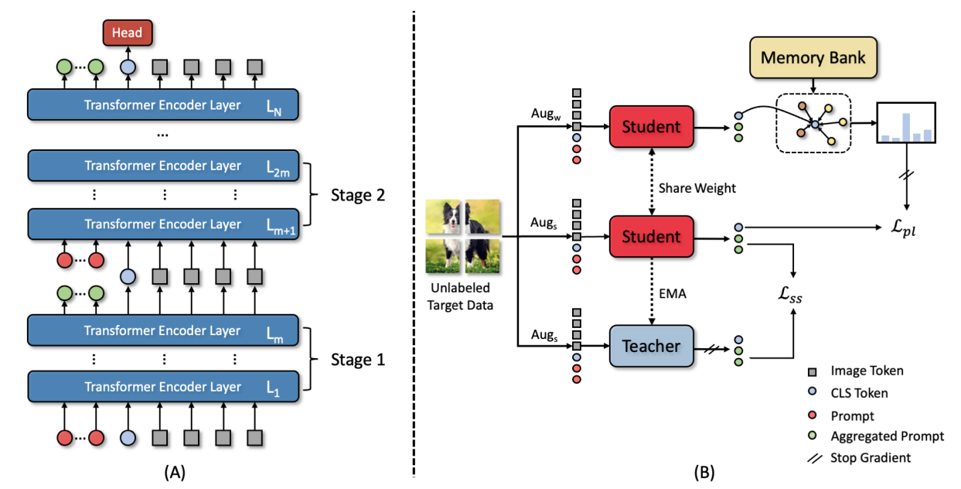
Prompt applications in CV-generalization
Visual Prompt Tuning for Test-time Domain Adaptation, Arxiv 2022
Notes:
The overview of DePT. (A) We split ViT into multiple stages and prepend prompts to the input of each stage. The prompts, along with the backbone, are initialized with labeled source domain data. Only prompts and the classification head (in red) are finetuned during adaptation, while the backbone is frozen (in blue). (B) The proposed adaptation framework. The pseudo labels of target data are first predicted and then refined by memory bank-based soft voting for self-training. A hierarchical self-supervised objective is proposed to improve target representation and alleviate
error accumulation of self-training.

Slide 58
Prompt applications in CV-generalization
Prompt Vision Transformer for Domain Generalization, Arxiv 2022
Motivation：ViT cannot generalize well to unseen domain.
Embedding the knowledge of source domain in domain prompts for target domain prediction.
Each domain prompt learns domain -specific knowledge, and prompt adapter produces suitable prompt for each input images.
The prompt adapter exploits the similarity between feature of OOD image and source domain, to integrate the source domain knowledge.

Slide 59
Prompt applications in CV-generalization
Prompt Vision Transformer for Domain Generalization, Arxiv 2022
prepended before ViT input tokens from the corresponding source domain

Slide 60
Prompt applications in CV-generalization
Visual Prompt Tuning for Test-time Domain Adaptation, Arxiv 2022
Motivation: TTA without accessing the source data. data-efficient prompt tuning.
two key ingredients:
Pluging visual prompts into ViT and only tunes these source-initialized prompts during adaptation;
Bootstraping the source representation to target domain by memory bank-based online pseudo-labeling.

Slide 61
Prompt applications in CV-generalization
Visual Prompt Tuning for Test-time Domain Adaptation, Arxiv 2022
Notes:
The overview of DePT. (A) We split ViT into multiple stages and prepend prompts to the input of each stage. The prompts, along with the backbone, are initialized with labeled source domain data. Only prompts and the classification head (in red) are finetuned during adaptation, while the backbone is frozen (in blue). (B) The proposed adaptation framework. The pseudo labels of target data are first predicted and then refined by memory bank-based soft voting for self-training. A hierarchical self-supervised objective is proposed to improve target representation and alleviate
error accumulation of self-training.

Slide 62
Prompt applications in CV-Segmentation
Explicit Visual Prompting for Low-Level Structure Segmentations, CVPR 2023
Low-level structure: segmenting the manipulated parts, identifying out-of-focus pixels, separating shadow regions, and detecting concealed objects.
A unified approach performs well across all of them.
Motivation : enforce the tunable parameters focusing on the explicit visual content from each individual image, i.e., the features from frozen patch embeddings and the input’s high-frequency components.
Our main insight is to tune the task-specific knowledge only from the features of each individual image itself because the pre-trained base model contains sufficient knowledge for semantic understanding.

Slide 63
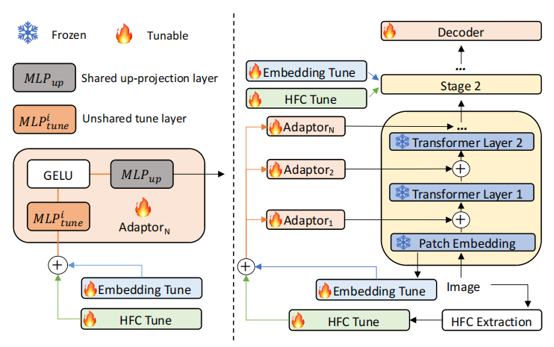
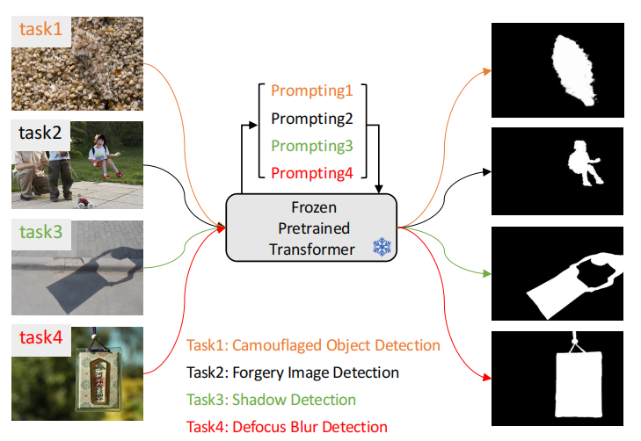
Prompt applications in CV-Segmentation
Explicit Visual Prompting for Low-Level Structure Segmentations, CVPR 2023

Slide 64
Prompt applications in CV
BlackVIP: Black-Box Visual Prompting for Robust Transfer Learning, CVPR 2023
Motivation: efficiently adapts the PTMs without knowledge about model architectures and parameters.
Coordinator (Prompt Reparameterization)：designs input-dependent image-shaped visual prompts, which improves few-shot adaptation and robustness on distribution /location shift.
Simultaneous perturbation stochastic approximation with gradient correction (SPSA-GC): estimates the gradient of a target model to update Coordinator

Slide 65
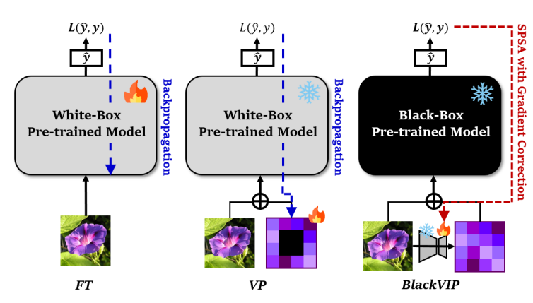
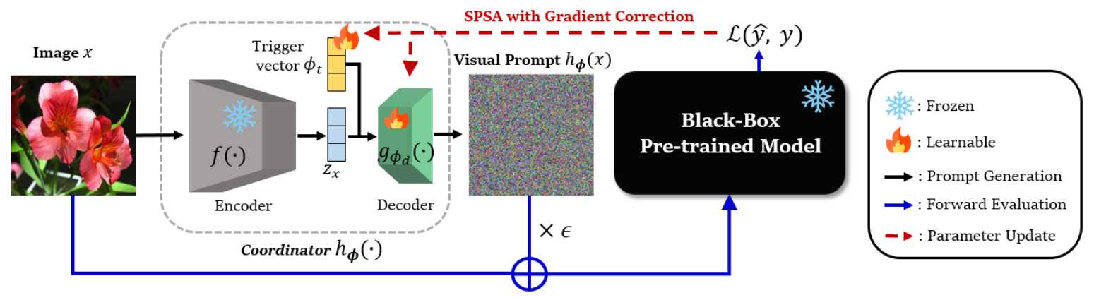
Prompt applications in CV
BlackVIP: Black-Box Visual Prompting for Robust Transfer Learning, CVPR 2023

Slide 66
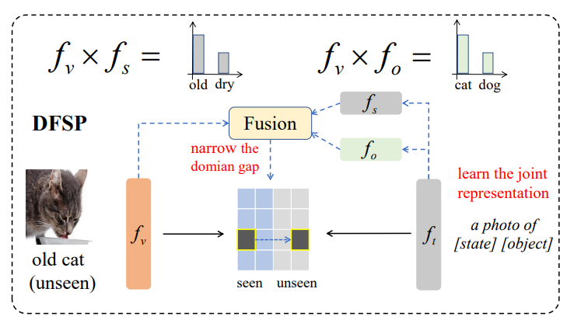
Prompt applications in CV
Decomposed Soft Prompt Guided Fusion Enhancing for Compositional Zero-Shot Learning, CVPR 2023
CZSL: recognize novel concepts formed by known states and objects during training.
Motivation : narrow the domain gap between seen and unseen compositions by fusing decomposed features with image feature, while learn the joint representation between state and object in language branch.

Slide 67
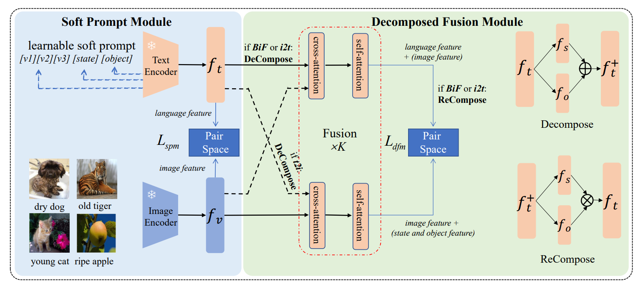
Prompt applications in CV
Decomposed Soft Prompt Guided Fusion Enhancing for Compositional Zero-Shot Learning, CVPR 2023
CZSL: recognize novel concepts formed by known states and objects during training.
Motivation : narrow the domain gap between seen and unseen compositions by fusing decomposed features with image feature, while learn the joint representation between state and object in language branch.

Slide 68
Prompt applications in CV-generzation
Visual Prompting via Image Inpainting, NeurIPS 2022 (9.1)
Motivation: Given input-output image example(s) of a new task at test time and a new input image, the goal is to automatically produce the output image, consistent with the given examples.
The visual prompt is composed of the desired task example(s) and a new query image.
Inpainting using MAE-VQGAN

Slide 69
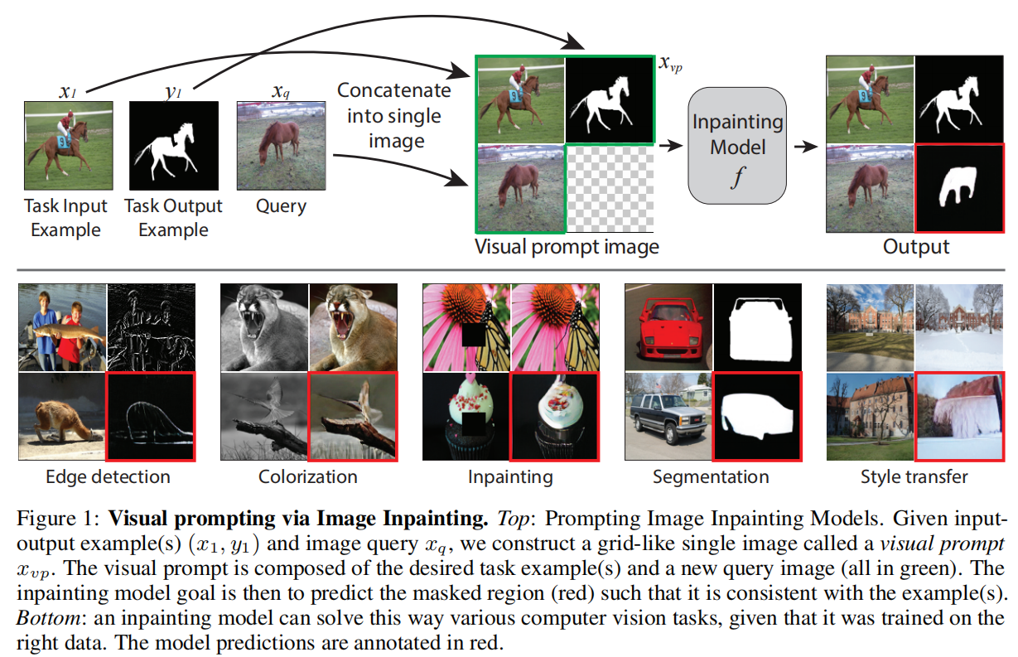
Prompt applications in CV-generation
Visual Prompting via Image Inpainting, NeurIPS 2022

Slide 70
Prompt applications in CV-generation
Visual prompt tuning for generative transfer learning, CVPR 2023
Transfer learning is not widely used for image synthesis.
Transferring knowledge from pre-trained GAN models, their demonstrations are limited to narrow visual domains.
Approach transfer learning for image synthesis using generative vision transformers, an emerging class of image synthesis models.
The first to adopt prompt tuning for transfer learning of image synthesis
We propose a parameter-efficient design of a prompt token generator that admits condition variables (e.g., class), a key for controllable image synthesis neglected in prompt tuning for discriminative transfer

Slide 71
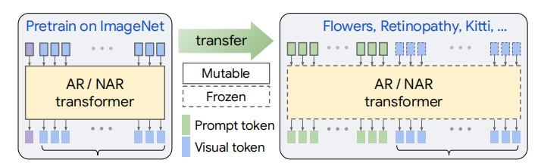
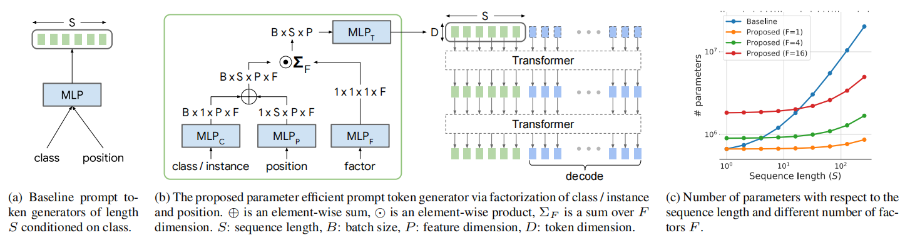
Prompt applications in CV-generation
Visual prompt tuning for generative transfer learning, CVPR 2023

Slide 72
Prompt applications in CV-generation
Zero-shot Generative Model Adaptation via Image-specific Prompt Learning, CVPR 2023
A key reason is that a fixed adaptation direction is applied for all cross-domain image pairs, which leads to identical supervision signals.
we propose an Image-specific Prompt Learning (IPL) method, which learns specific prompt vectors for each source-domain image.

Slide 73
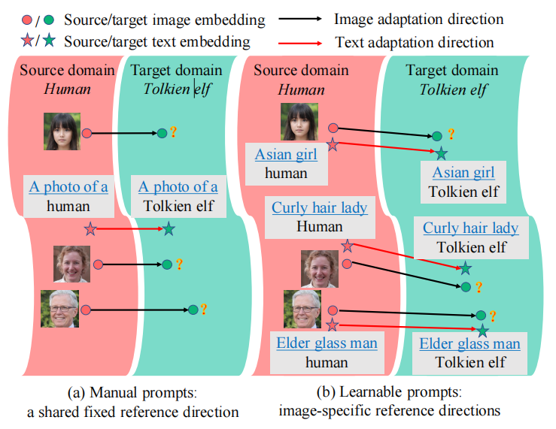
Prompt applications in CV-generation
Zero-shot Generative Model Adaptation via Image-specific Prompt Learning, CVPR 2023

Slide 74
Prompt applications in CV-segmentation
Boosting Low-Data Instance Segmentation by Unsupervised Pre-training with Saliency Prompt, CVPR 2023
Query-based end-to-end instance segmentation (QEIS) methods have recently outperformed CNN-based models on large-scale datasets.
Boosts QEIS models by giving Saliency Prompt for queries/kernels.
Prompt-Kernel Matching transfers pseudo masks into prompts and injects the corresponding localization and shape priors to the best-matched kernels.

Slide 75
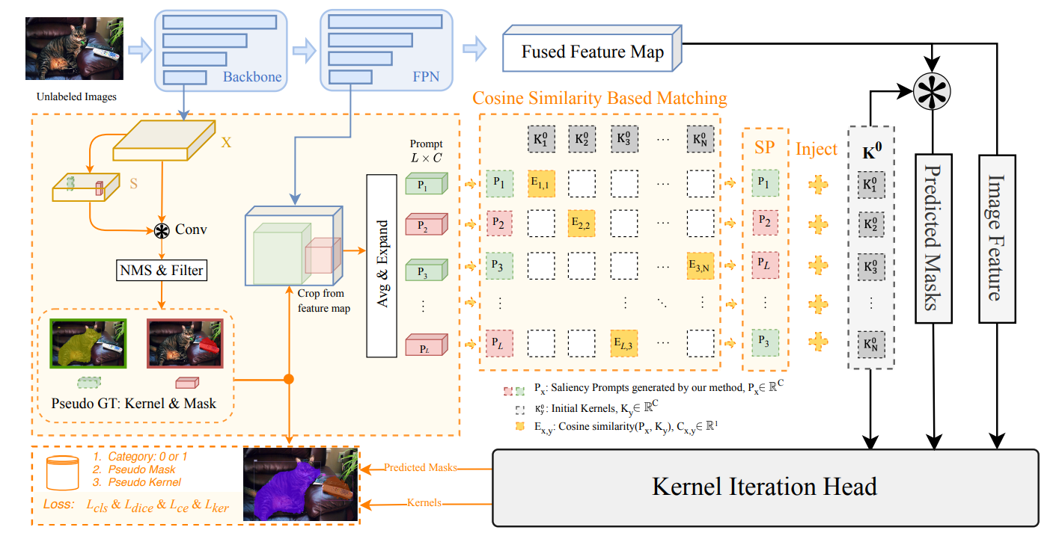
Prompt applications in CV-segmentation
Boosting Low-Data Instance Segmentation by Unsupervised Pre-training with Saliency Prompt, CVPR 2023

Slide 76
Prompt applications in CV-generlization
Prompt Vision Transformer for Domain Generalization, Arxiv 2022
Motivation：ViT cannot generalize well to unseen domain.
Embedding the knowledge of source domain in domain prompts for target domain prediction.
Each domain prompt learns domain -specific knowledge, and prompt adapter produces suitable prompt for each input images.
The prompt adapter exploits the similarity between feature of OOD image and source domain, to integrate the source domain knowledge.

Slide 77
Prompt applications in CV-generlization
Prompt Vision Transformer for Domain Generalization, Arxiv 2022
prepended before ViT input tokens from the corresponding source domain

Slide 78
Prompt applications in CV-generalization
Visual Prompt Tuning for Test-time Domain Adaptation, Arxiv 2022
Motivation: TTA without accessing the source data. data-efficient prompt tuning.
two key ingredients:
Pluging visual prompts into ViT and only tunes these source-initialized prompts during adaptation;
Bootstraping the source representation to target domain by memory bank-based online pseudo-labeling.

Slide 79
Prompt applications in CV-generlization
Visual Prompt Tuning for Test-time Domain Adaptation, Arxiv 2022
Notes:
The overview of DePT. (A) We split ViT into multiple stages and prepend prompts to the input of each stage. The prompts, along with the backbone, are initialized with labeled source domain data. Only prompts and the classification head (in red) are finetuned during adaptation, while the backbone is frozen (in blue). (B) The proposed adaptation framework. The pseudo labels of target data are first predicted and then refined by memory bank-based soft voting for self-training. A hierarchical self-supervised objective is proposed to improve target representation and alleviate
error accumulation of self-training.

Slide 80
Prompt applications in CV
FashionSAP: Symbols and Attributes Prompt for Fine-grained Fashion Vision-Language Pre-training, CVPR 2023
During training on downstream tasks, only the parameters of prompts and linear head are updated while the whole Transformer encoder is frozen.

Slide 81
Prompt applications in CV
FashionSAP: Symbols and Attributes Prompt for Fine-grained Fashion Vision-Language Pre-training, CVPR 2023
During training on downstream tasks, only the parameters of prompts and linear head are updated while the whole Transformer encoder is frozen.

Slide 82
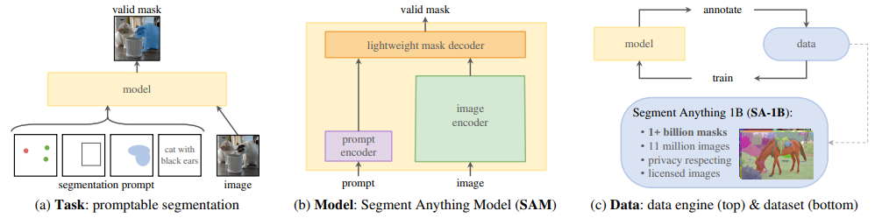
Prompt applications in CV-segmentation
Segment Anything, CVPR 2023
Grounded-SAM + Stable-Diffusion Inpainting: Data-Factory, Generating New Data!
Grounded-Segment-Anything: Marrying Grounding DINO with Segment Anything & Stable Diffusion & BLIP - Automatically Detect , Segment and Generate Anything with Image and Text Inputs

Slide 83
Prompt applications in Medical Imaging
SAM on Medical Images A Comprehensive Study on Three Prompt Modes, 2023
The large scale dataset and its promptable nature endow the model with strong zero-shot generalization.
Investigate its zero-shot generalization on medical images.
More than 12 public medical image datasets that cover various organs and modalities.
What kind of prompt can lead to the best zero-shot performance with different modalities.
Results：The SAM zero-shot results are generally lower than SOTA results, but there are still several datasets that obtain performance exceeding SOTA.

Slide 84
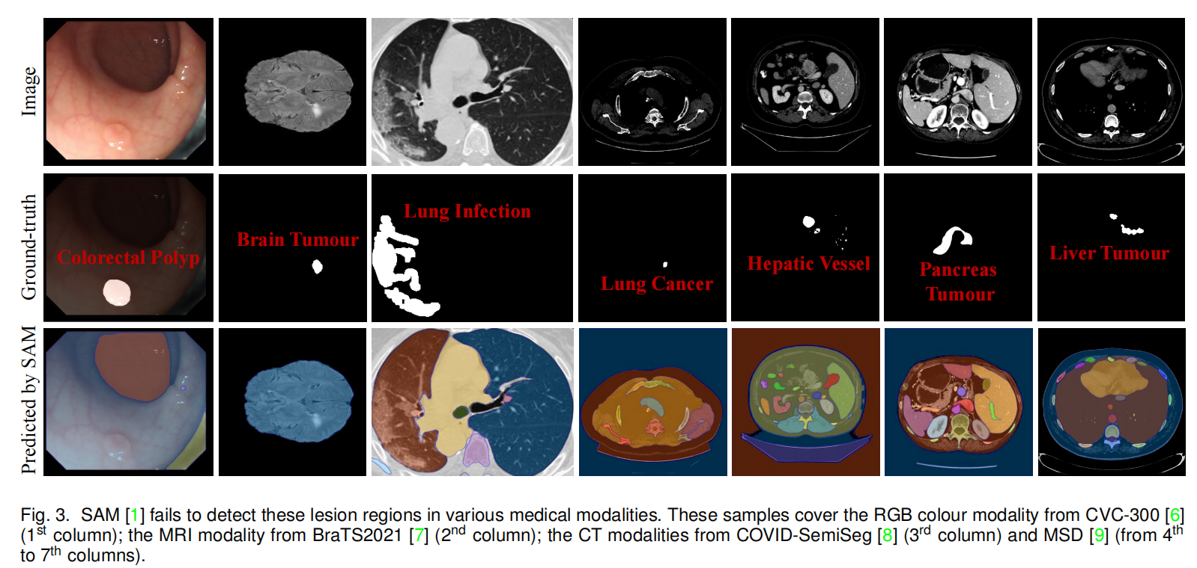
Prompt applications in Medical Imaging
SAM Struggles in Concealed Scenes Empirical Study on Segment Anything, 2023
Three concealed scenes, i.e., camouflaged animals, industrial defects, and medical lesions.
Our main observation is that SAM looks unskilled in concealed scenes.

Slide 85

Prompt applications in Medical Imaging
SAM.MD Zero-shot medical image segmentation capabilities of the segment anything model, 2023
Conduct an initial evaluation of the out-of-the-box zero-shot capabilities of SAM for medical image segmentation, by evaluating its performance on an abdominal CT organ segmentation task, via point or bounding box based prompting.
We show that SAM generalizes well to CT data, making it a potential catalyst for the advancement of semi-automatic segmentation tools for clinicians.
We believe that this foundation model, while not reaching SOTA segmentation performance in our investigations, can serve as a highly potent starting point for further adaptations of such models to the intricacies of the medical domain.

Slide 86
Prompt applications in Medical Imaging
SAMM (segment any medical model) a 3D slicer integration to SAM, 2023
Introduce Segment Any Medical Model (SAMM), an extension of SAM on 3D Slicer, a widely-used open-source image processing and visualization software.

Slide 87
Prompt applications in Medical Imaging
Segment Anything Model for Medical Image Analysis an Experimental Study, 2023
Segment Anything Model for Medical Images?
Accuracy of Segment-Anything Model (SAM) in medical image segmentation tasks

Slide 88
Prompt applications in Medical Imaging
Exploring visual prompts for whole slide image classification with multiple instance learning, CVPR 2023
Motivation: learning domain-specific knowledge transformation from pre-trained models to histopathology images.
Using a prompt component to assist the pre-trained model in discerning differences between the pre-trained dataset and the target histopathology dataset.

Slide 89


Prompt applications in Medical Imaging
Exploring visual prompts for whole slide image classification with multiple instance learning, CVPR 2023

Slide 90

Prompt applications in Medical Imaging
Learning Federated Visual Prompt in Null Space for MRI Reconstruction, CVPR 2023
.

Slide 91
Prompt applications in Medical Imaging
GPT4MIA: Utilizing Generative Pre-trained Transformer (GPT-3) as A Plug-and-Play Transductive Model for Medical Image Analysis, Arxiv 2023
During training on downstream tasks, only the parameters of prompts and linear head are updated while the whole Transformer encoder is frozen.

Slide 92

Prompt applications in Medical Imaging
Adapting pre-trained vision-language foundational models to medical imaging domains, Arxiv 2022
Seek to research and expand the representational capabilities of large pretrained foundation models to medical concepts, specifically for leveraging the Stable Diffusion model to generate domain specific images found in medical imaging.

Slide 93

Prompt applications in Medical Imaging
Adapting pre-trained vision-language foundational models to medical imaging domains, Arxiv 2022

Slide 94

Prompt applications in Medical Imaging
UniverSeg: Universal Medical Image Segmentation
We present UniverSeg, a method for solving unseen medical segmentation tasks without additional training.

Slide 95
Prompt applications in Medical Imaging
LMPT: Prompt Tuning with Class-Specific Embedding Loss for Long-Tailed Multi-Label Visual Recognition, Arxiv 2023
we propose a unified framework for LTML capturing the semantic feature interactions between categories by combining text and image modality data and improving the performance synchronously on both head and tail classes.

Slide 96
Prompt applications in Medical Imaging
Napss: Paragraph-level medical text simplification via narrative prompting and sentence-matching summarization, Arxiv 2023
Open-Ended Medical Visual Question Answering Through Prefix Tuning of Language Model, Arxiv 2022
.

Slide 97
Prompt applications in Medical Imaging
Medial image understanding with pre-trained vision language models a comprehensive study, 2023
During training on downstream tasks, only the parameters of prompts and linear head are updated while the whole Transformer encoder is frozen.

Slide 98
Thanks!
Any Question?

